Slide 1
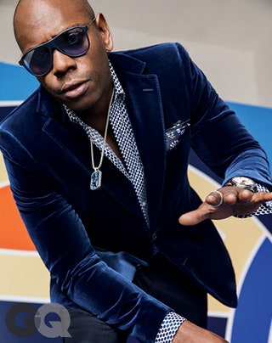
Proposal
Iron Table Holdings
Presented by

Slide 2
Table of Contents
Welcome
Founder & CEO
Dave’s Quote
Stay Connected
Benefits
The Campaign
VIPAllAccess4Life
Cost Breakdown
Thank You!
1
2
3
4
5
6
7
8
9
2

Slide 3
Founder & CEO
OVERVIEW
Our primary focus is creating new and innovative ways to interact with fans and customers. As a one-stop multi-media digital company, we are fully equipped with the industry’s latest technological knowledge. We are forward-thinkers and offer not only something unique, but a new and exciting approach to help clients meet their goals and objectives. Our plan is to Introduce, Enhance and Change the game! This technology is bursting on the scene, and we are helping to fill the gap in this socially distant world. Join us and become a “forerunner” of this exciting and amazing technology.
This new venture is exciting, and I am so proud to be
able to offer this amazing opportunity. ~ Monique
Monique Henderson-Ford
A businesswoman with over 25 years of intel and entrepreneurial experience. She has launched and maintained three successful business brands in the retail, clothing design and technology space. A passionate visionary and strategist whose creativity help companies build new ways to meet their goals and ultimately grow their bottom line.
3

Slide 4
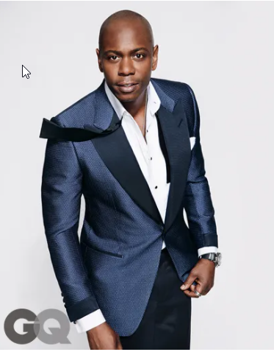
~ The mark of greatness is when everything before you is obsolete, and everything after you bears your mark. ~
htahthatleoait
4

Slide 5
Fans Want To Stay Connected
Staying connected and engaged is pivotal for succeeding in this ever-changing digital world. One way to build brand love and loyalty is to provide exclusive opportunities for fans to engage up close and personal. The “Insider” feeling is invaluable when it comes to keeping fans dedicated. We will provide that access! TapNGoPros will provide the ultimate digital technology experience. This ground-breaking technology gives your fans real-time specialized content. You will be able to interact one-on-one, control the message, push the information you want to build brand love and loyalty! This type of inclusion will make your fans feel special and valued , which boosts their support of your brand. The excitement your fans will feel in “Dave’s Universe” is animated, exhilarating and most importantly, TIMELESS!
5

Slide 6
Benefits
01.
BE THE FIRST!
No other person on this PLANET is marketing at this level!
02.
TRENDSETTER!
Be the FIRST to introduce this forward-thinking technology to your fans!
03.
IT’S SUPER DOPE!
Amazing & Exciting Technology!
6

Slide 7
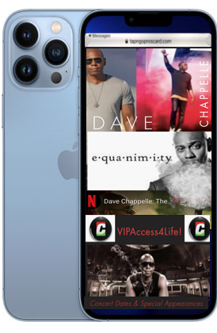
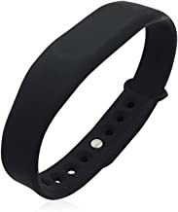
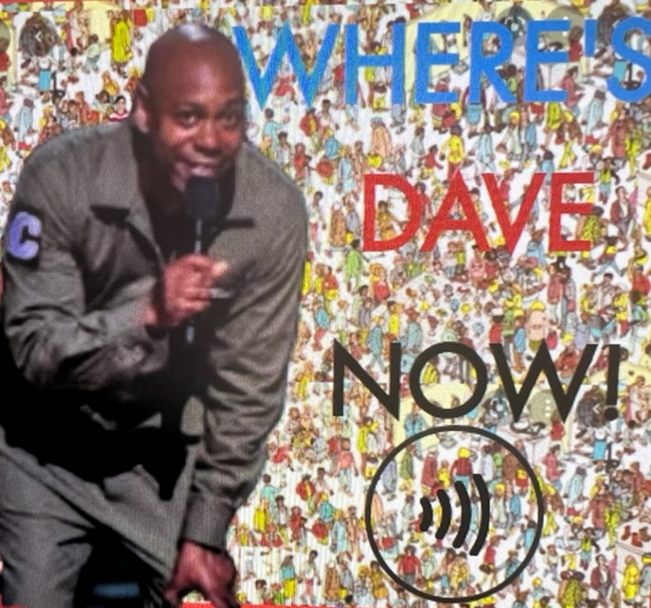
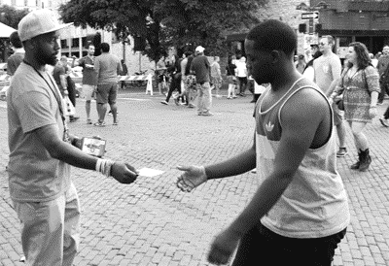
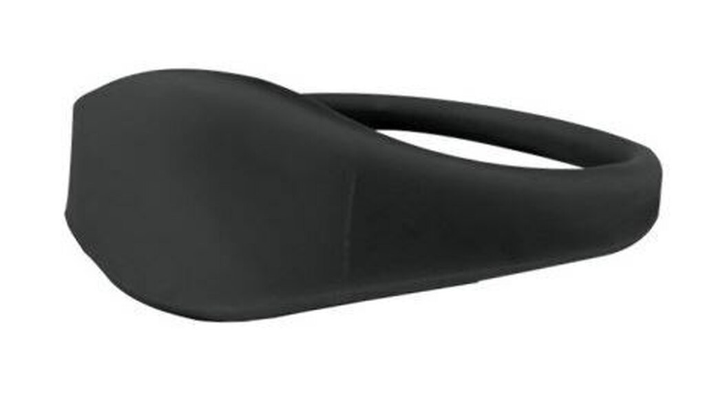
The
Campaign
Fans now have access to your controlled content for the rest of their lives!
Distribution of technology embedded postcards, buttons, and merchandise.
Your fans could merely TAP and get real-time, up-to-the-minute information and
controlled content you provide.
01
Tap Technology
03
Streamlined Design Facilitation
Marketing products would be embedded with this new technology.
Mobile and web content design for production and distribution.
02
Data Collection
04
Promotion
Digital pages and controlled content for Fans & Enthusiasts. Learn more about your fans and what they want.
Promotional Street Team and merchandise creation & distribution from online orders and Live events.
33/8 x 21/8 VIP card
Wearables| Buttons | Promo Cards
Analytic Data Collection
Digital & Mobile Design
Marketing Street Team
7

Slide 8
VIPAllAccess4Life Black Card
Fans can be a part of this elite opportunity by simply
purchasing the All-Access Black Card.
This card will open the door to exclusive content in real-time, surprise appearances, opportunities for specialized merchandise made available to them
24/7 with just a TAP!
8

Slide 9
Cost Breakdown
Yearly Contract Agreement
Monthly Fee
Curation of controlled content onto mobile page(s)
Four (4) content page updates per month
Unlimited analytical data reports
Curation of controlled content onto mobile page(s)
Two (2) content page updates per month
One (1) analytical data report per month
~ Additional Turn-Key Opportunities ~
Printing & curation of promotional elements (i.e., cards & buttons)
Promotional Street Team (at select cities)
*Additional cost may vary
9

Slide 10
Thank You
Get In Touch With Us
Monique Henderson-Ford
Founder & CEO
TapNGoPros
2801 Pinole Valley Road , Ste. 206, Pinole, CA 94564
www.tapngopros.com
510.219.0857
TapNGoPros
info@tapngopros.com
@TapNGoPros

